Slide 1
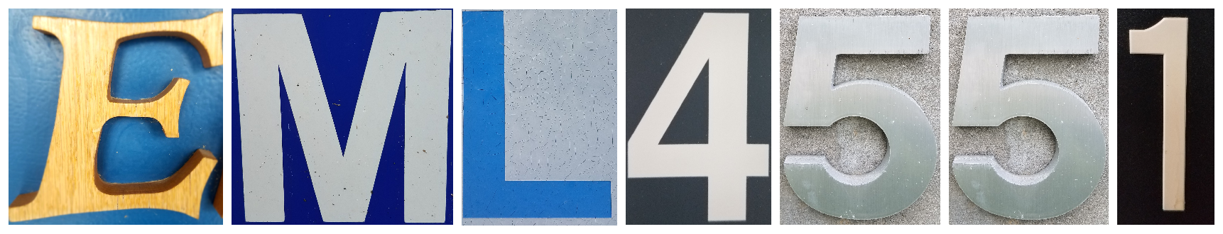
Virtual Design Review 2
Convertible High Heel Shoe
D. Brown – O. Jegede

Slide 2
Overview
Team Introductions
Project Summary
Review
Target Catalog
Target summary
Concept Generation
Olapido

Slide 3




Introductions – Senior Design Team
Team Leader
Kali J. Nelson
ME Student
Lead ME
Dalton C. Brown
ME Student
Financial Advisor
Olapido A. Jegede
ME Student
Publications Director
Zachariah D.
Pramschufer
ME Student
Olapido

Slide 4
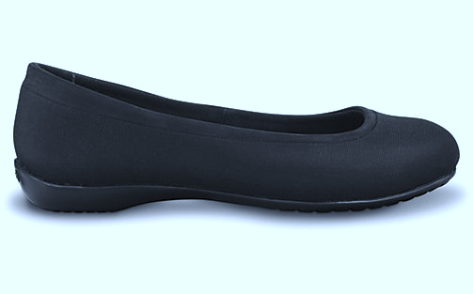
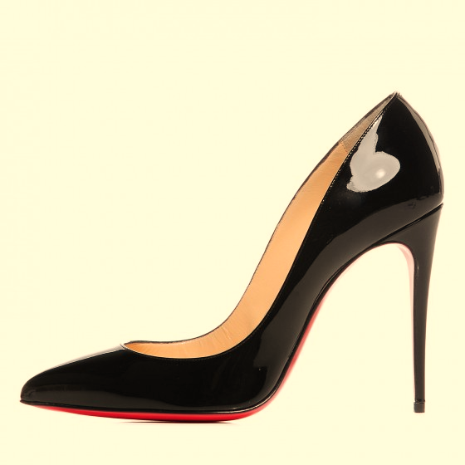
Project Summary
The team is tasked with designing convertible shoe that can transition between a flat state and a high heel state.
The convertible shoe will be fashionable, comfortable, and inexpensive.
Olapido

Slide 5

Project Summary – InNOLEvation Challenge
Event | Date | Status
Intent to Compete | November 3rd, 2017 | Completed
Business Model Canvas | January 16th, 2018 | In Progress
Complete and Final Business Model Canvas | February 8th, 2018 | Not Started
Executive Summary | February 27th, 2018 | Not Started
Final Judging | March 2nd, 2018 | Not Started
Olapido
Notes:
The InNOLEvation® Challenge is a Business Model Competition with a focus on identifying problems and potential solutions, building effective teams and precisely defining the assumptions of a new venture, testing those assumptions in the field, and then pivoting based on the lessons learned.

Slide 6
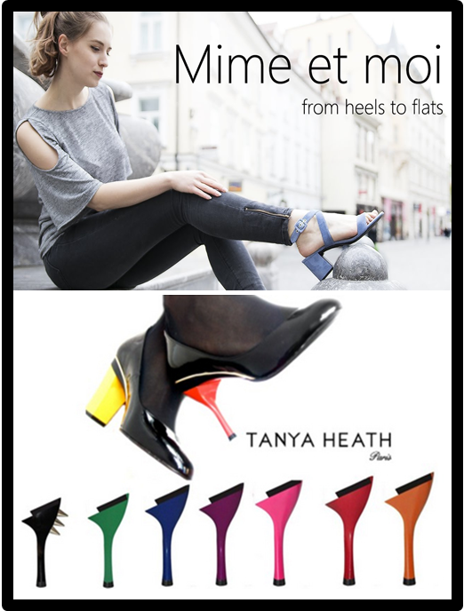
Review of Past Work
Background research
  High Heel shoes lead to discomfort and have numerous negative side effects
  High heels are still worn despite this
Key goals
  Fashionable
  Practical
Competitors
  Too unconventional for professional settings
  Too expensive for the average person
Olapido

Slide 7
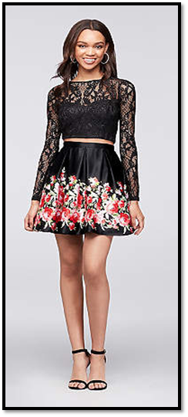

Review of Past Work – Continued
Market
  Women age 15-45
  Professional and personal use
Customer needs
  High heeled shoes are dangerous for prolonged use
  Current convertible shoes too expensive
  Removable pieces are inconvenient
Olapido

Slide 8
Review of Past Work – Functional Decomp.
Transform to Different Heights
Attach to Foot
Support Foot Ergonom-ically
Shield from Elements
Supply Traction
Impress with Style
Provide Comfort
Olapido

Slide 9
Target Catalog
Metrics | Targets
Heel height in elevated state | Roughly 3 in.
Heel height in flat state | Less than ½ in.
Shoe size | 10 ½
Cost to consumer | Less than $100
Stays connected to foot under normal wear | Yes
Olapido

Slide 10
Target Catalog – Continued
Metrics | Targets
Comfort level | Above 5 on Testing Scale in flat state
Stylish design | Above 5 on Testing Scale in elevated state
Ergonomic sole design | Yes
Acceptable shoe traction to avoid slippage under normal wear | Yes
Easily transformable between states | Yes
Olapido

Slide 11

Target Summary
In order to avoid obtaining approval from the Institutional Review Board for Protection of Human Subjects in Research (IRB), shoe sizing will be designed around the one female team member.
Cost target was obtained from previous survey.
Olapido
Notes:
IRB’s are difficult and lengthy to obtain both both Hruda and Devine suggested against getting one.
As engineers we are more focused on the mechanical aspect of design rather than the overall appeal.

Slide 12
Target Summary – Continued
Alleviation of discomfort is a requirement.
  Sole needs to be ergonomically designed.
  Sole material needs to be a compromise between rigid and flexible.
Women want to be stylish.
  A compromise between aesthetics and practicality needs to be found.
  RMPD student, Naomi Cohen was recruited to assist in this design aspect.
Olapido

Slide 13
Target Summary – Testing Scale
Comfort and Style cannot be directly measured
Testing with the prototype will be conducted
  Comfort based testing for the flat state
  Style based testing for the elevated state
Scale of one to ten used for testing
A five is considered acceptable for a simple prototype
Olapido
Notes:
Since human testing is difficult, the testing pool may be very small and possibly just Kali.
Since comfort and style cannot be simply measured, tests will be administered with the prototype of the shoe. These tests will use a scale of one to ten. For comfort, a one will represent how the subject feels after roughly two to three hours of wearing high heels and a ten will represent what the subject considers to be a comfortable pair of shoes. The subject will then wear the prototype of the convertible shoe in the flat state and report their level of comfort on the scale from one to ten. For style, a one will represent what the subject considers an unstylish, unprofessional shoe appearance and a ten will represent what the subject considers to be a stylish pair of high heel shoes. The subject will then observe the convertible shoe in its heel state both up close and being worn and report how stylish they view the shoes to be on the scale of one to ten. Details of the testing process and the testing scale may be adjusted at a later date, but this will be the basic process used to measure style and comfort. Due to the subjective nature of these tests and the unclear nature of just how finalized a prototype will be able to be constructed, a reasonable goal of at least a five out of ten on both testing scales will be set. This target may be moved up depending on how close to a final product the team is able to get with the prototype.

Slide 14
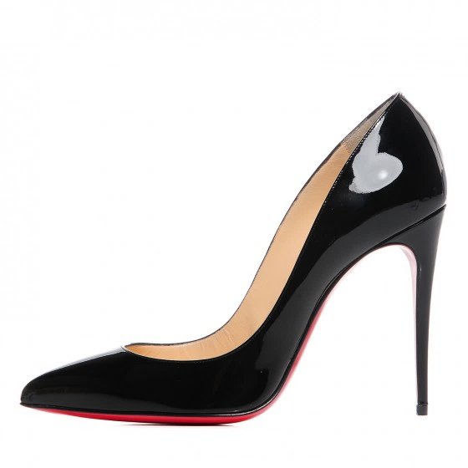
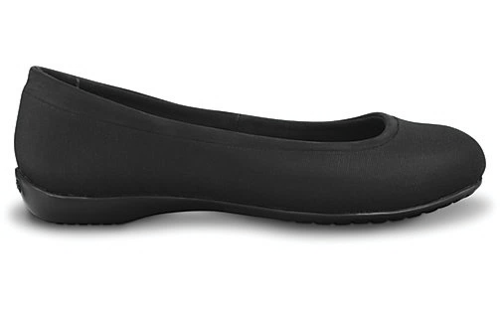
Heel Mechanism
Changeable angle of inclination
Changeable exterior fabric around ball of foot

Slide 15
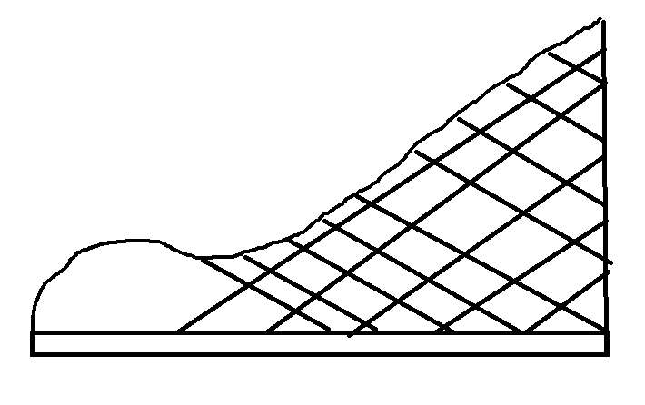
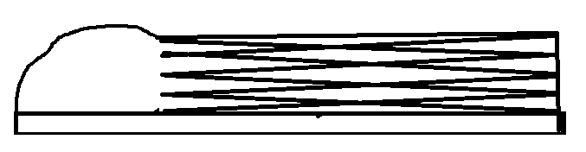
Heel Mechanism – Origami Design Concept
Description: A wedge heel that can be flattened or expanded based on the user’s height preference.
Pros: Unique visual style, no removable parts
Cons: Only works with wedge heels, potentially dangerous for high loads
Dalton

Slide 16
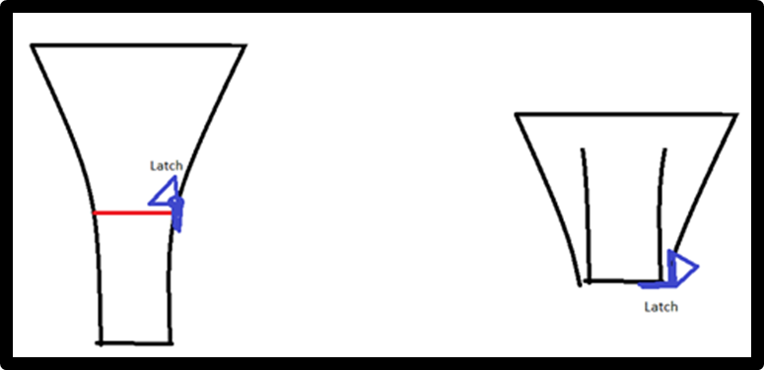
Heel Mechanism – Telescoping Concept
Description: This design uses a telescoping mechanism in order to go into the upper part of the heel.
Pros: No removable parts
Cons: Larger heel size in flat state
Dalton

Slide 17
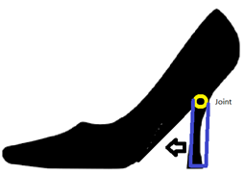
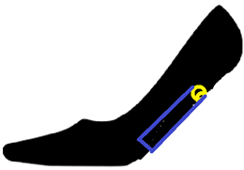
Heel Mechanism – Folding Heel Concept 1
Description: Uses a hinge or joint that allows the the heel to pivot
Pros: Simple to implement, no removable parts
Cons: Requires thick sole
Dalton

Slide 18
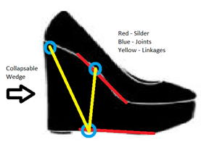
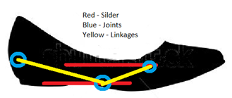
Heel Mechanism – Three Bar Mechanism
Description: This concept uses a three bar mechanism with two sliders where the joints are linked to the sliders
Pros: No removable parts
Cons: Complexity in design
Dalton

Slide 19
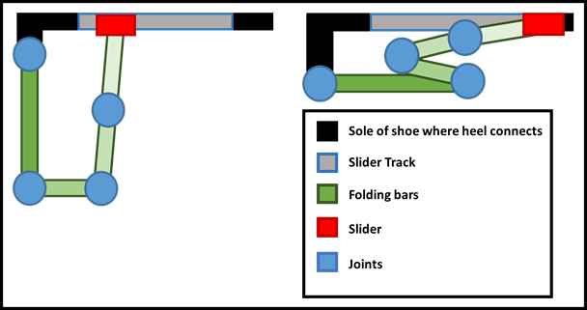
Heel Mechanism – Folding Heel Concept 2
Description: The heel folds into a five bar mechanism
Pros: Allows simple design and easy transitioning
Cons: Heel mechanism consumes space
Dalton

Slide 20
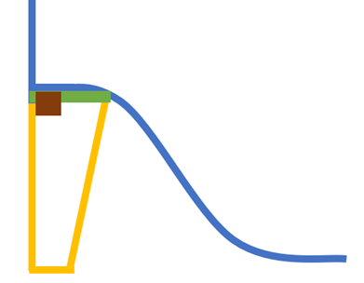

Heel Mechanism – Hug, Slide Heel Concept
Description: Three plates connect to form a triangular heel. Plates can be unclasped to allow transitioning from elevated to flat
Pros: Allows transitioning from height to totally flat
Cons: Limited heel height
Dalton

Slide 21
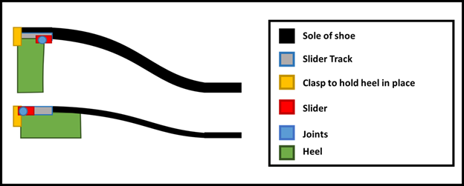
Heel Mechanism – Slide, Swivel Heel Concept
Description: Heel that can alternate between two heel heights using a sliding mechanism in unison with a locking mechanism.
Pros: No removable parts
Cons: Heel always has to be somewhat elevated
Dalton

Slide 22
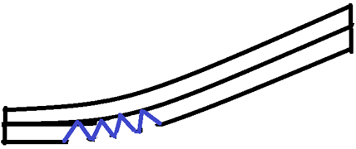

Changeable Angle – Bottom of Insole Flexibility
Description: Sole flexibility is in state of tension when elevated and in state of compression when flat to accommodate change in heel angle.
Pros: Simple to design
Cons: Vulnerable to external hazards
Dalton

Slide 23
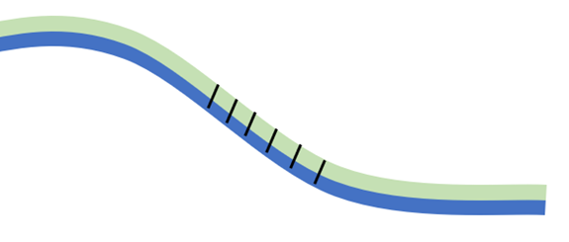

Changeable Angle – Top of Insole Flexibility
Description: Sole flexibility is in state of tension when flat and in state of compression when elevated to accommodate change in heel angle.
Pros: Protected from external hazards
Cons: Would need specific materials not used in soles
Dalton

Slide 24
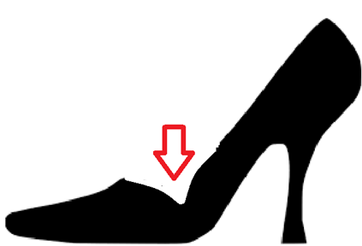
Separate Fabric at Joint so the Sides move Freely
Changeable Exterior Fabric –
Description: Toe box has a fabric covering independent to the rest of the shoe.
Pros: Prevents fabric buckling when transitioning between elevated and flat state
Cons: More steps in the manufacturing process.
Dalton

Slide 25
Conclusion
Tangible goals have been set.
Variety of methods for solving our three major design problems:
  Heel Mechanism
  Changeable angle of inclination
  Changeable exterior fabric around ball of foot
Concept selection can begin to take place.
Dalton

Slide 26
References
[1] Osteoarthritis. (n.d.). Retrieved October 15, 2017, from http://www.arthritis.org/about-arthritis/types/osteoarthritis
[2] The effects of high heeled shoes on female gait: A review. (2014, January 24). Retrieved October 15, 2017, from http://www.sciencedirect.com/science/article/pii/S10506411140002 5X?via%3Dihub
[3] Metatarsalgia. (2016, November 04). Retrieved October 15, 2017, from http://www.mayoclinic.org/diseases- conditions/metatarsalgia/symptoms-causes/syc-20354790

Slide 27
Questions?

